Slide 1
Successful Medicaid Enrollment
Strategies to Cover the Uninsured
Chartpack
June 2015

Slide 2
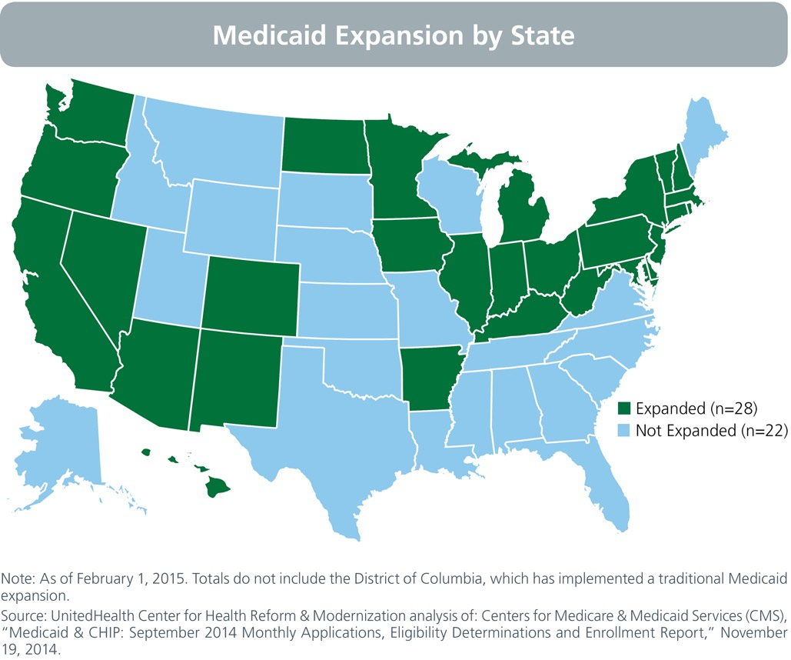
Since enactment of the Affordable Care Act, 28 states have expanded Medicaid, either through traditional expansions or via waiver authority.

Slide 3
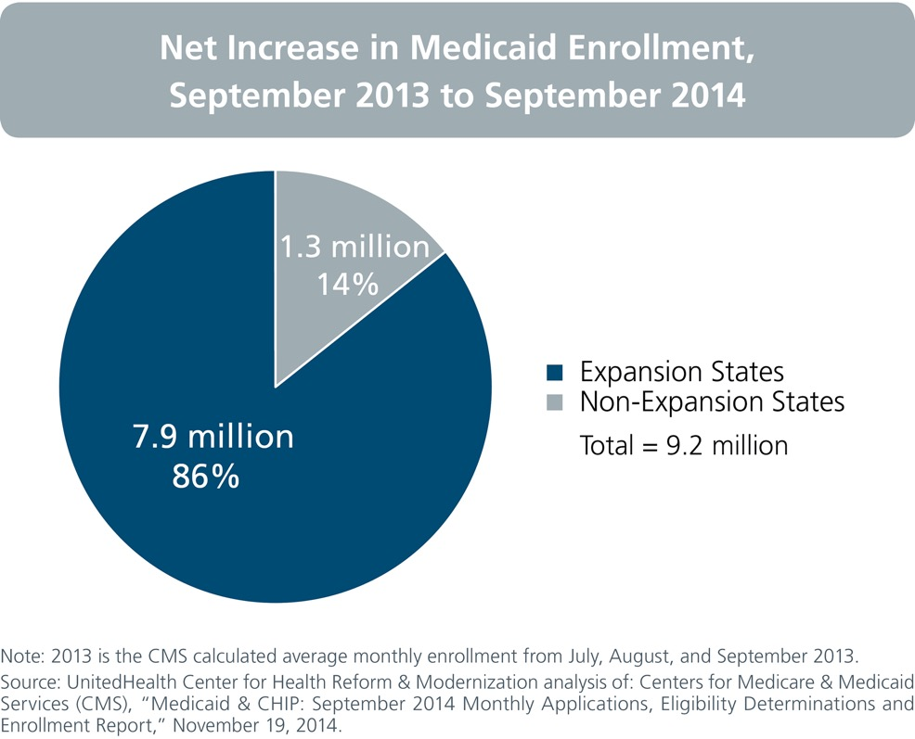
States implementing Medicaid expansion accounted for 86% of the 9.2 million national enrollment increase in 2014.

Slide 4
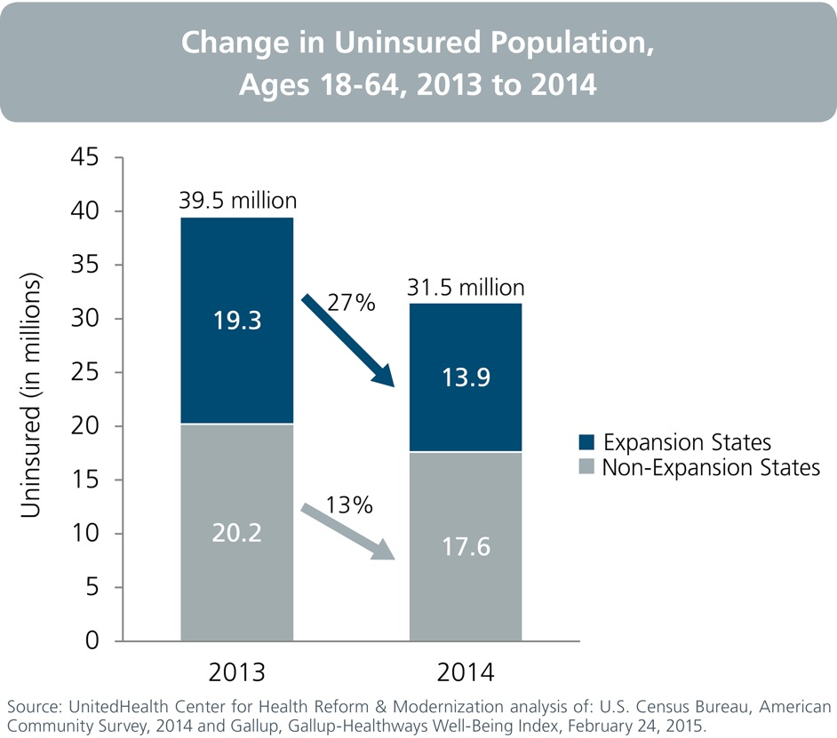
The number of uninsured adults decreased by 8 million between 2013 and 2014, driven mainly by a decline in expansion states.

Slide 5
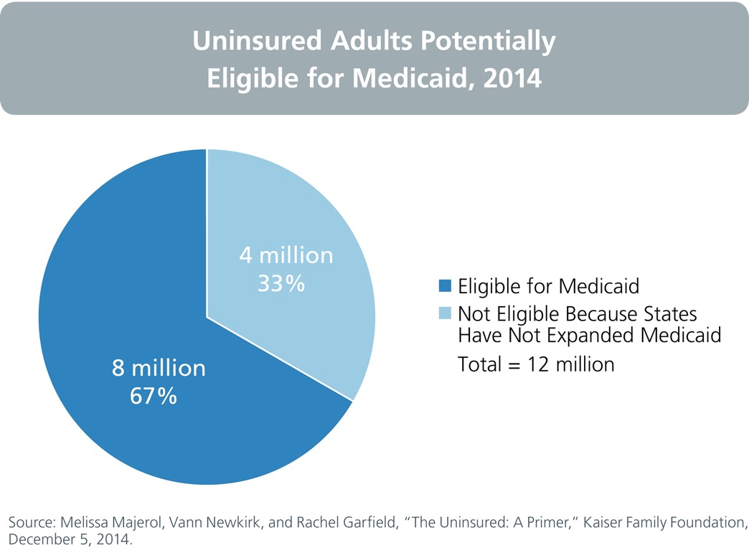
An estimated 12 million uninsured adults – one out of every three – could be covered by Medicaid.

Slide 6
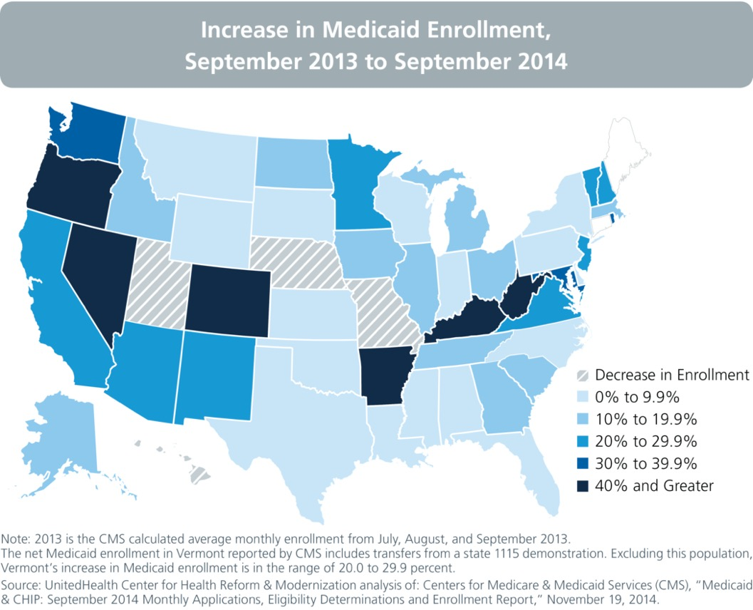
Among states expanding Medicaid, changes in enrollment ranged from small decreases to a 76% increase in Kentucky.

Slide 7
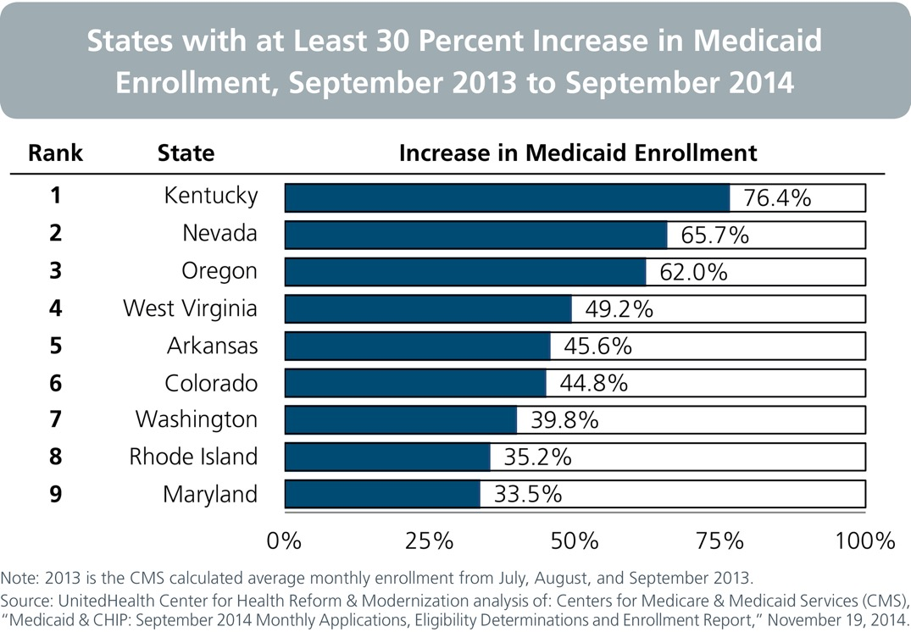
Nine expansion states achieved an increase in overall Medicaid enrollment of 30 percent or more.

Slide 8
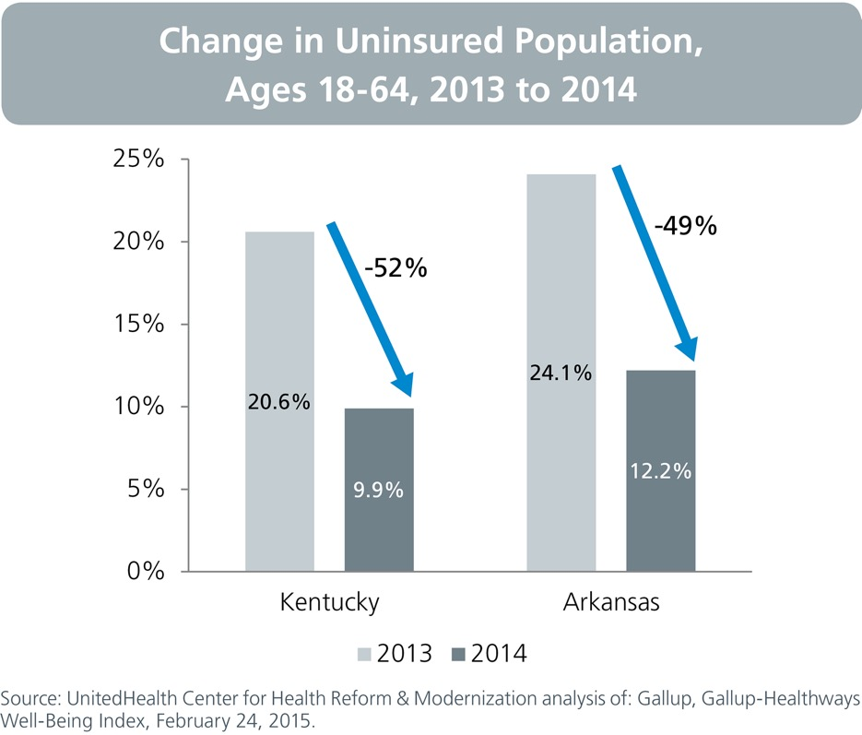
In one year, both Kentucky and Arkansas effectively cut in half their uninsured rate for adults.

