Slide 1
Advancing Primary Care Delivery: Practical, Proven, and Scalable Approaches Chartpack
UnitedHealth Center for
Health Reform & Modernization
September 2014

Slide 2
Advancing Primary Care Delivery: Practical, Proven, and Scalable Approaches
Primary care is the foundation of the U.S. health care system, central to improving health and to effectively treating patients.
The United States faces a challenge in terms of increasing overall primary care capacity and aligning the supply of primary care resources with demand in underserved communities.
Building blocks for increasing capacity include leveraging a diverse clinical workforce, practicing in care teams, and utilizing health information technology (HIT).
Care delivery models that leverage these building blocks have improved quality and contained costs, by applying value-based payments.
Additional pathways to expand and target capacity include leveraging retail health clinics, reaching patients where they live, utilizing group visits, and better targeting “super-utilizers” and other complex patients.
The full report can be accessed at unitedhealthgroup.com/modernization

Slide 3
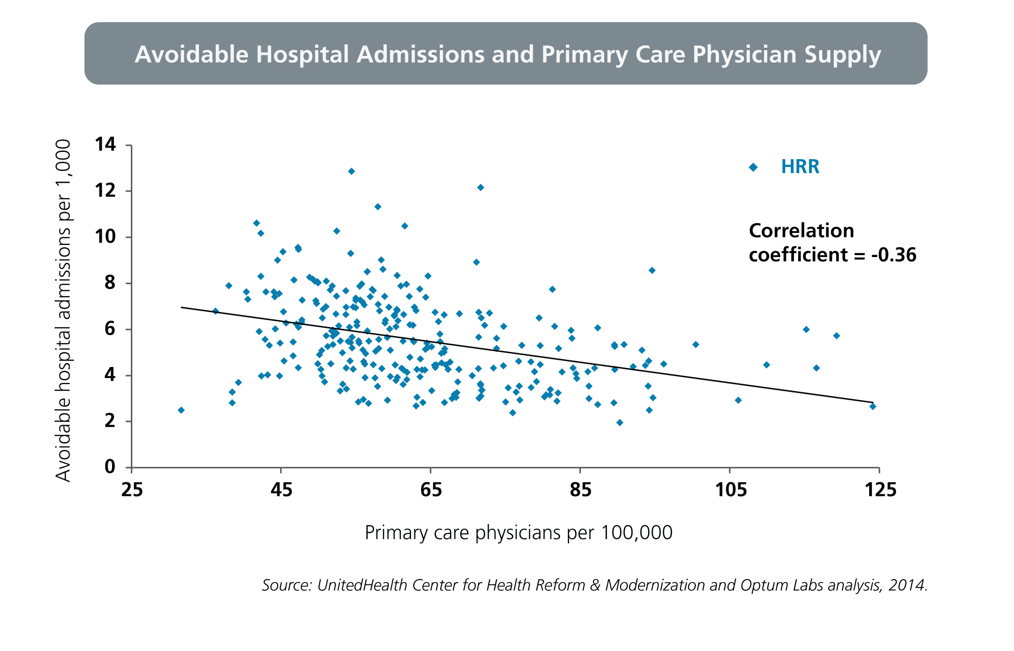
Health Care Markets with a Higher Concentration of Primary Care Physicians Have Fewer Avoidable Hospital Admissions

Slide 4
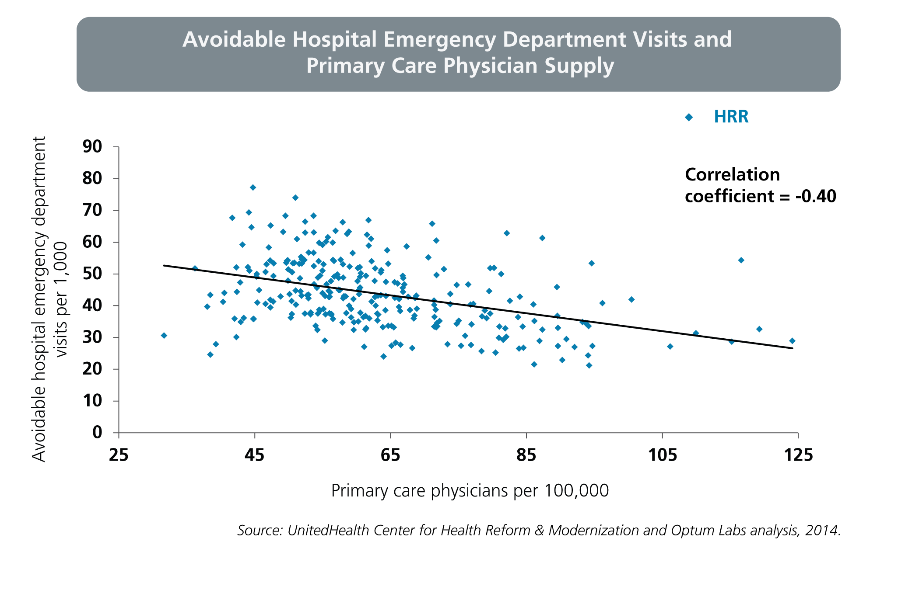
Health Care Markets with a Higher Concentration of Primary Care Physicians Have Fewer Avoidable Hospital Emergency Department Visits

Slide 5
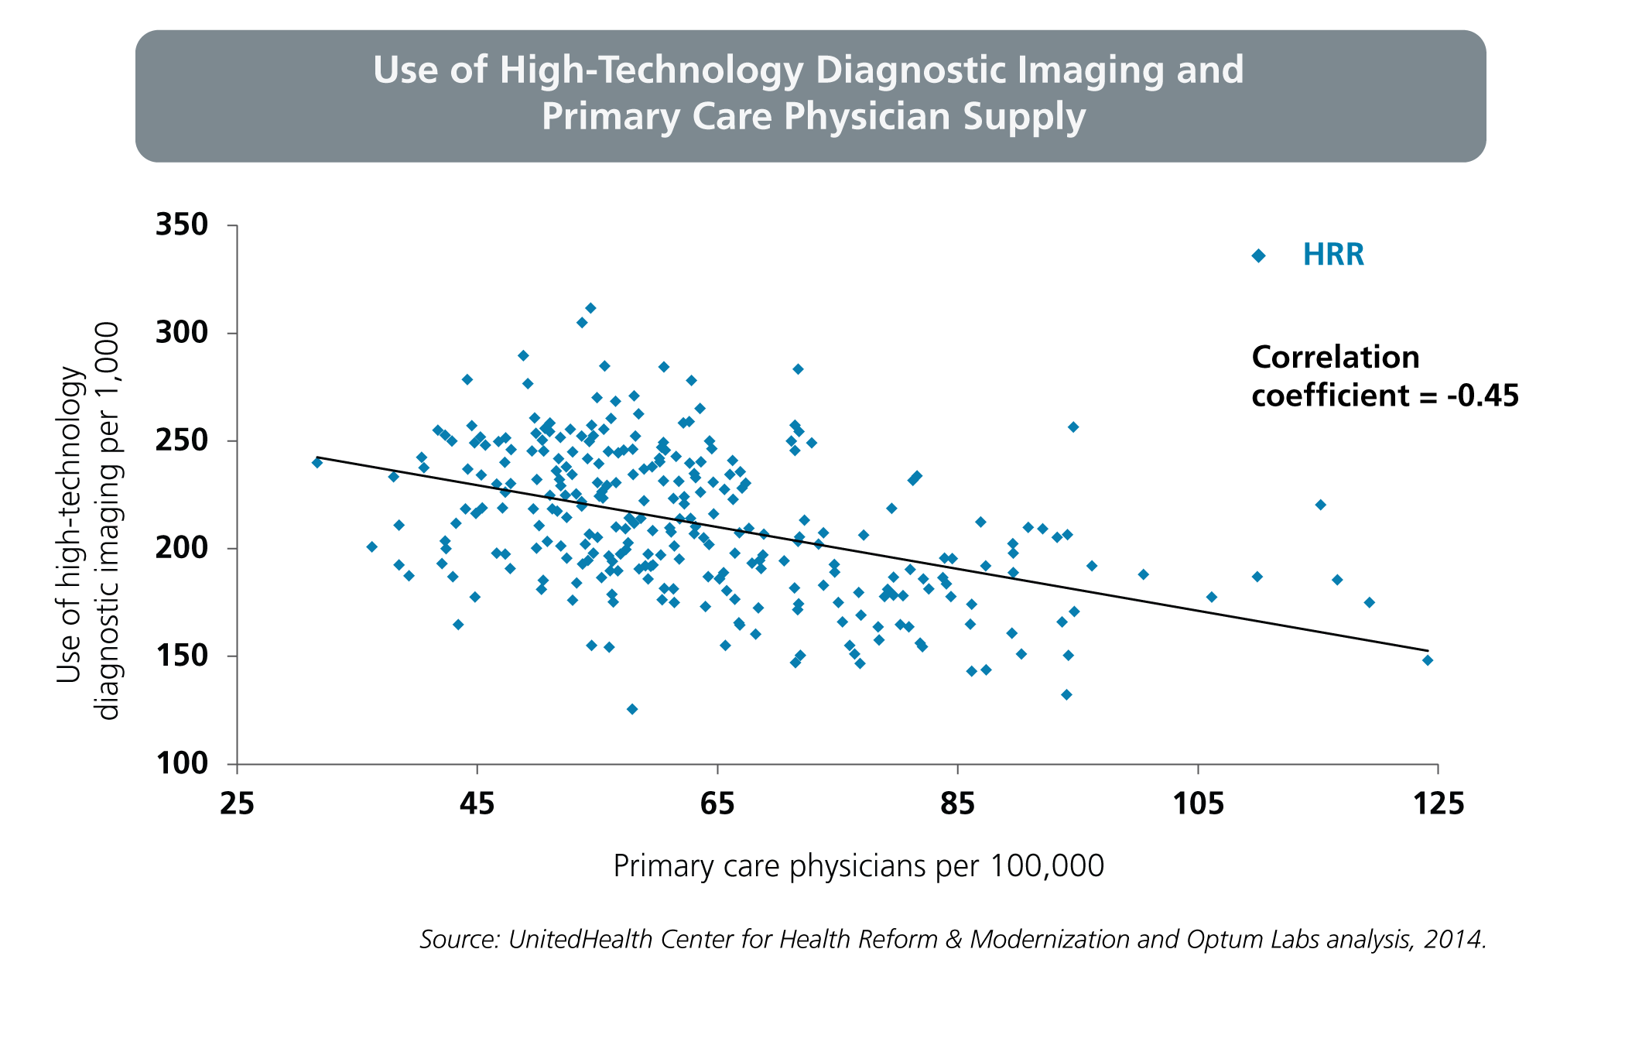
Health Care Markets with a Higher Concentration of Primary Care Physicians Have Lower Use of High-Technology Diagnostic Imaging, Which is More Costly and Often No More Effective Than Traditional Imaging

Slide 6
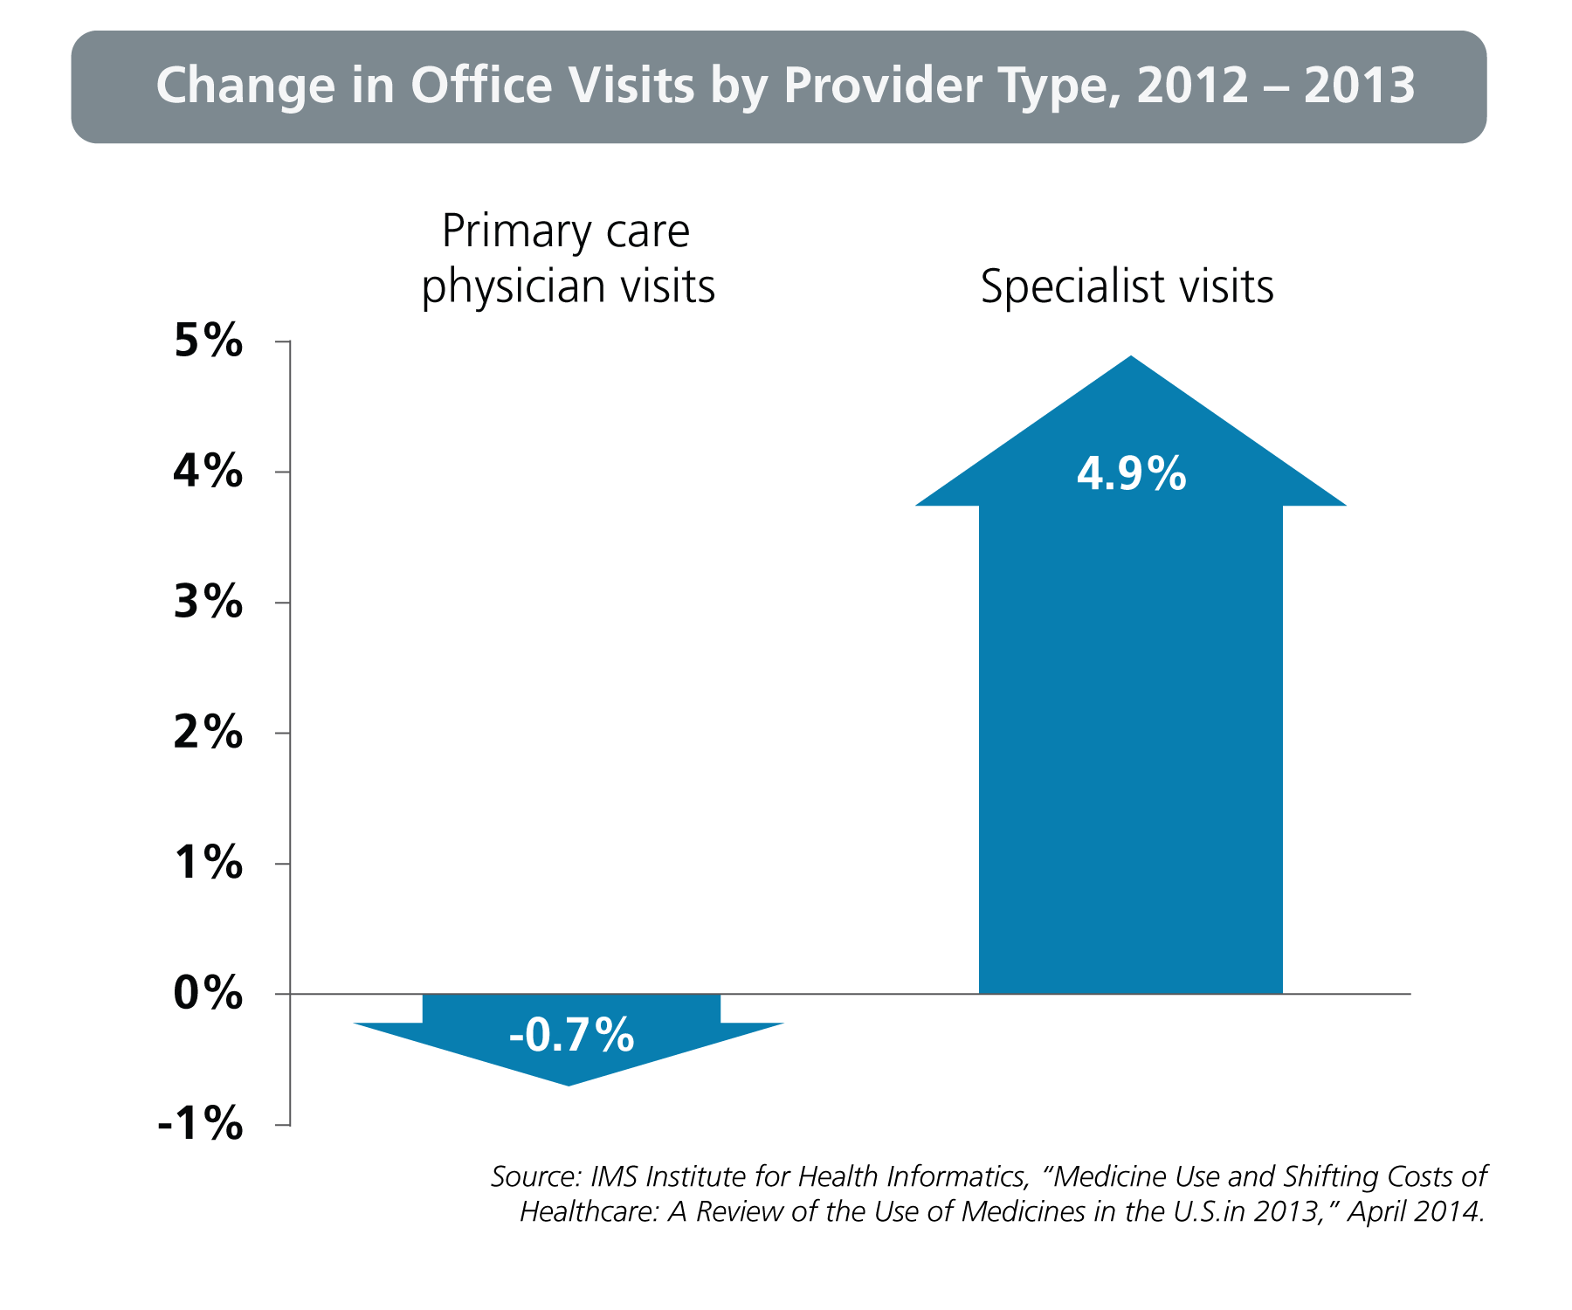
The Volume of Primary Care Physician Visits in the United States Declined and Specialist Visits Increased Between 2012 and 2013

Slide 7
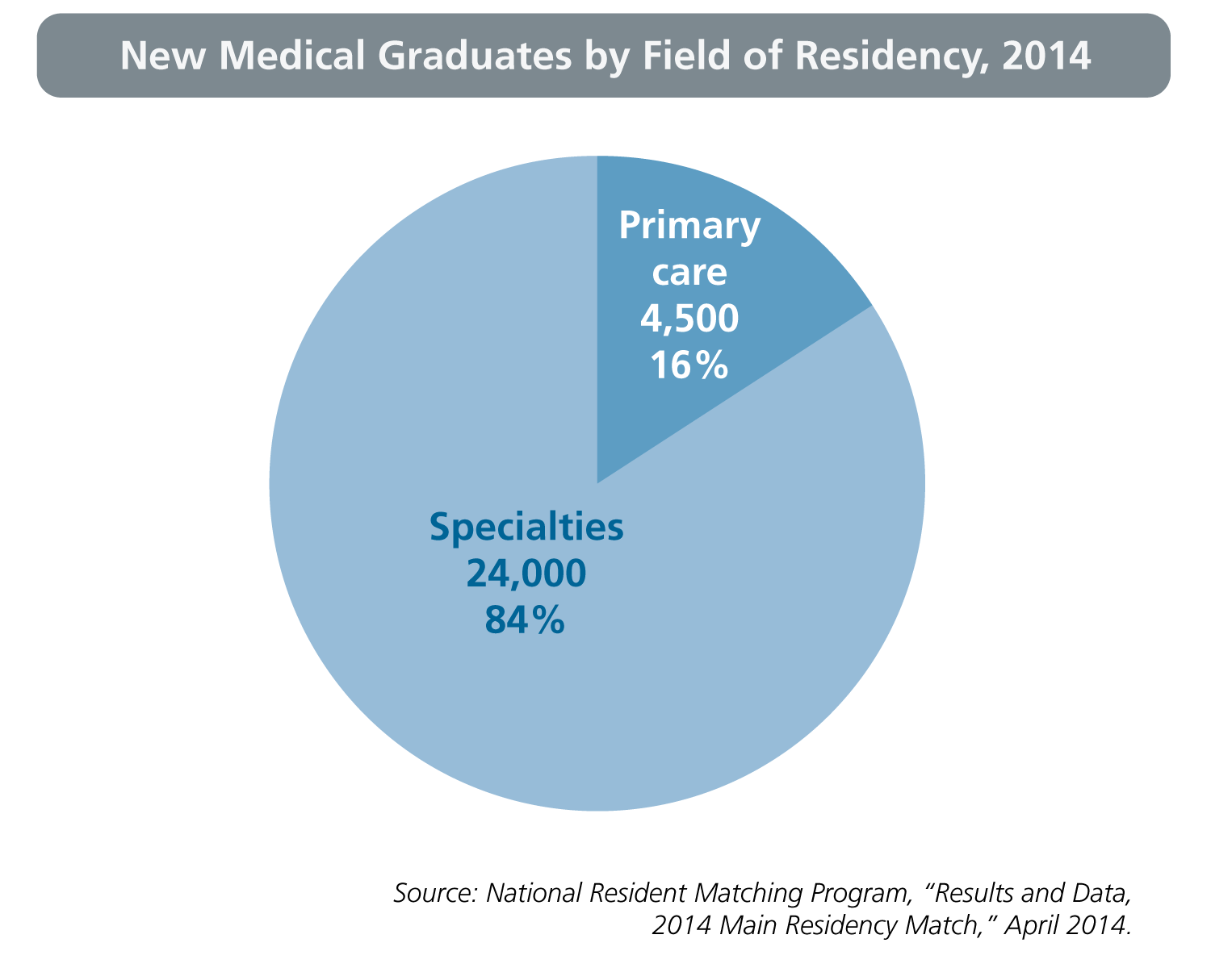
Among New Medical School Graduates, Only One in Six is Choosing to Practice Primary Care

Slide 8
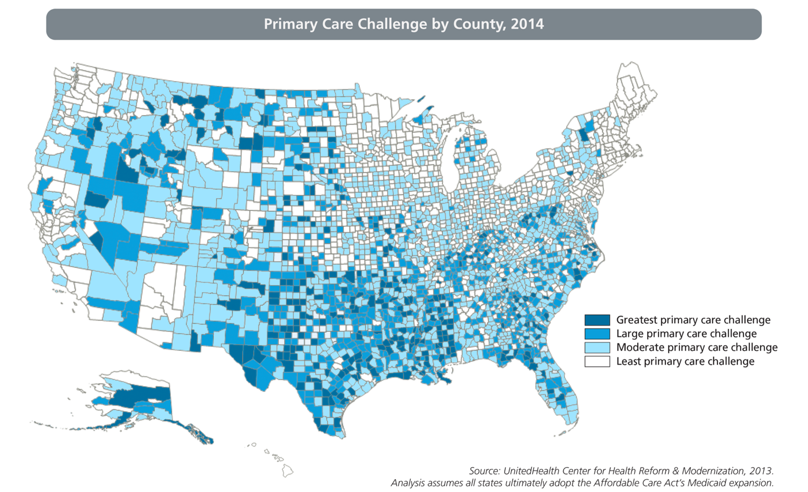
Some Areas of the Country, Including the West and the South, Face Greater Challenges than Others in Ensuring Primary Care Capacity in the Coming Years

Slide 9
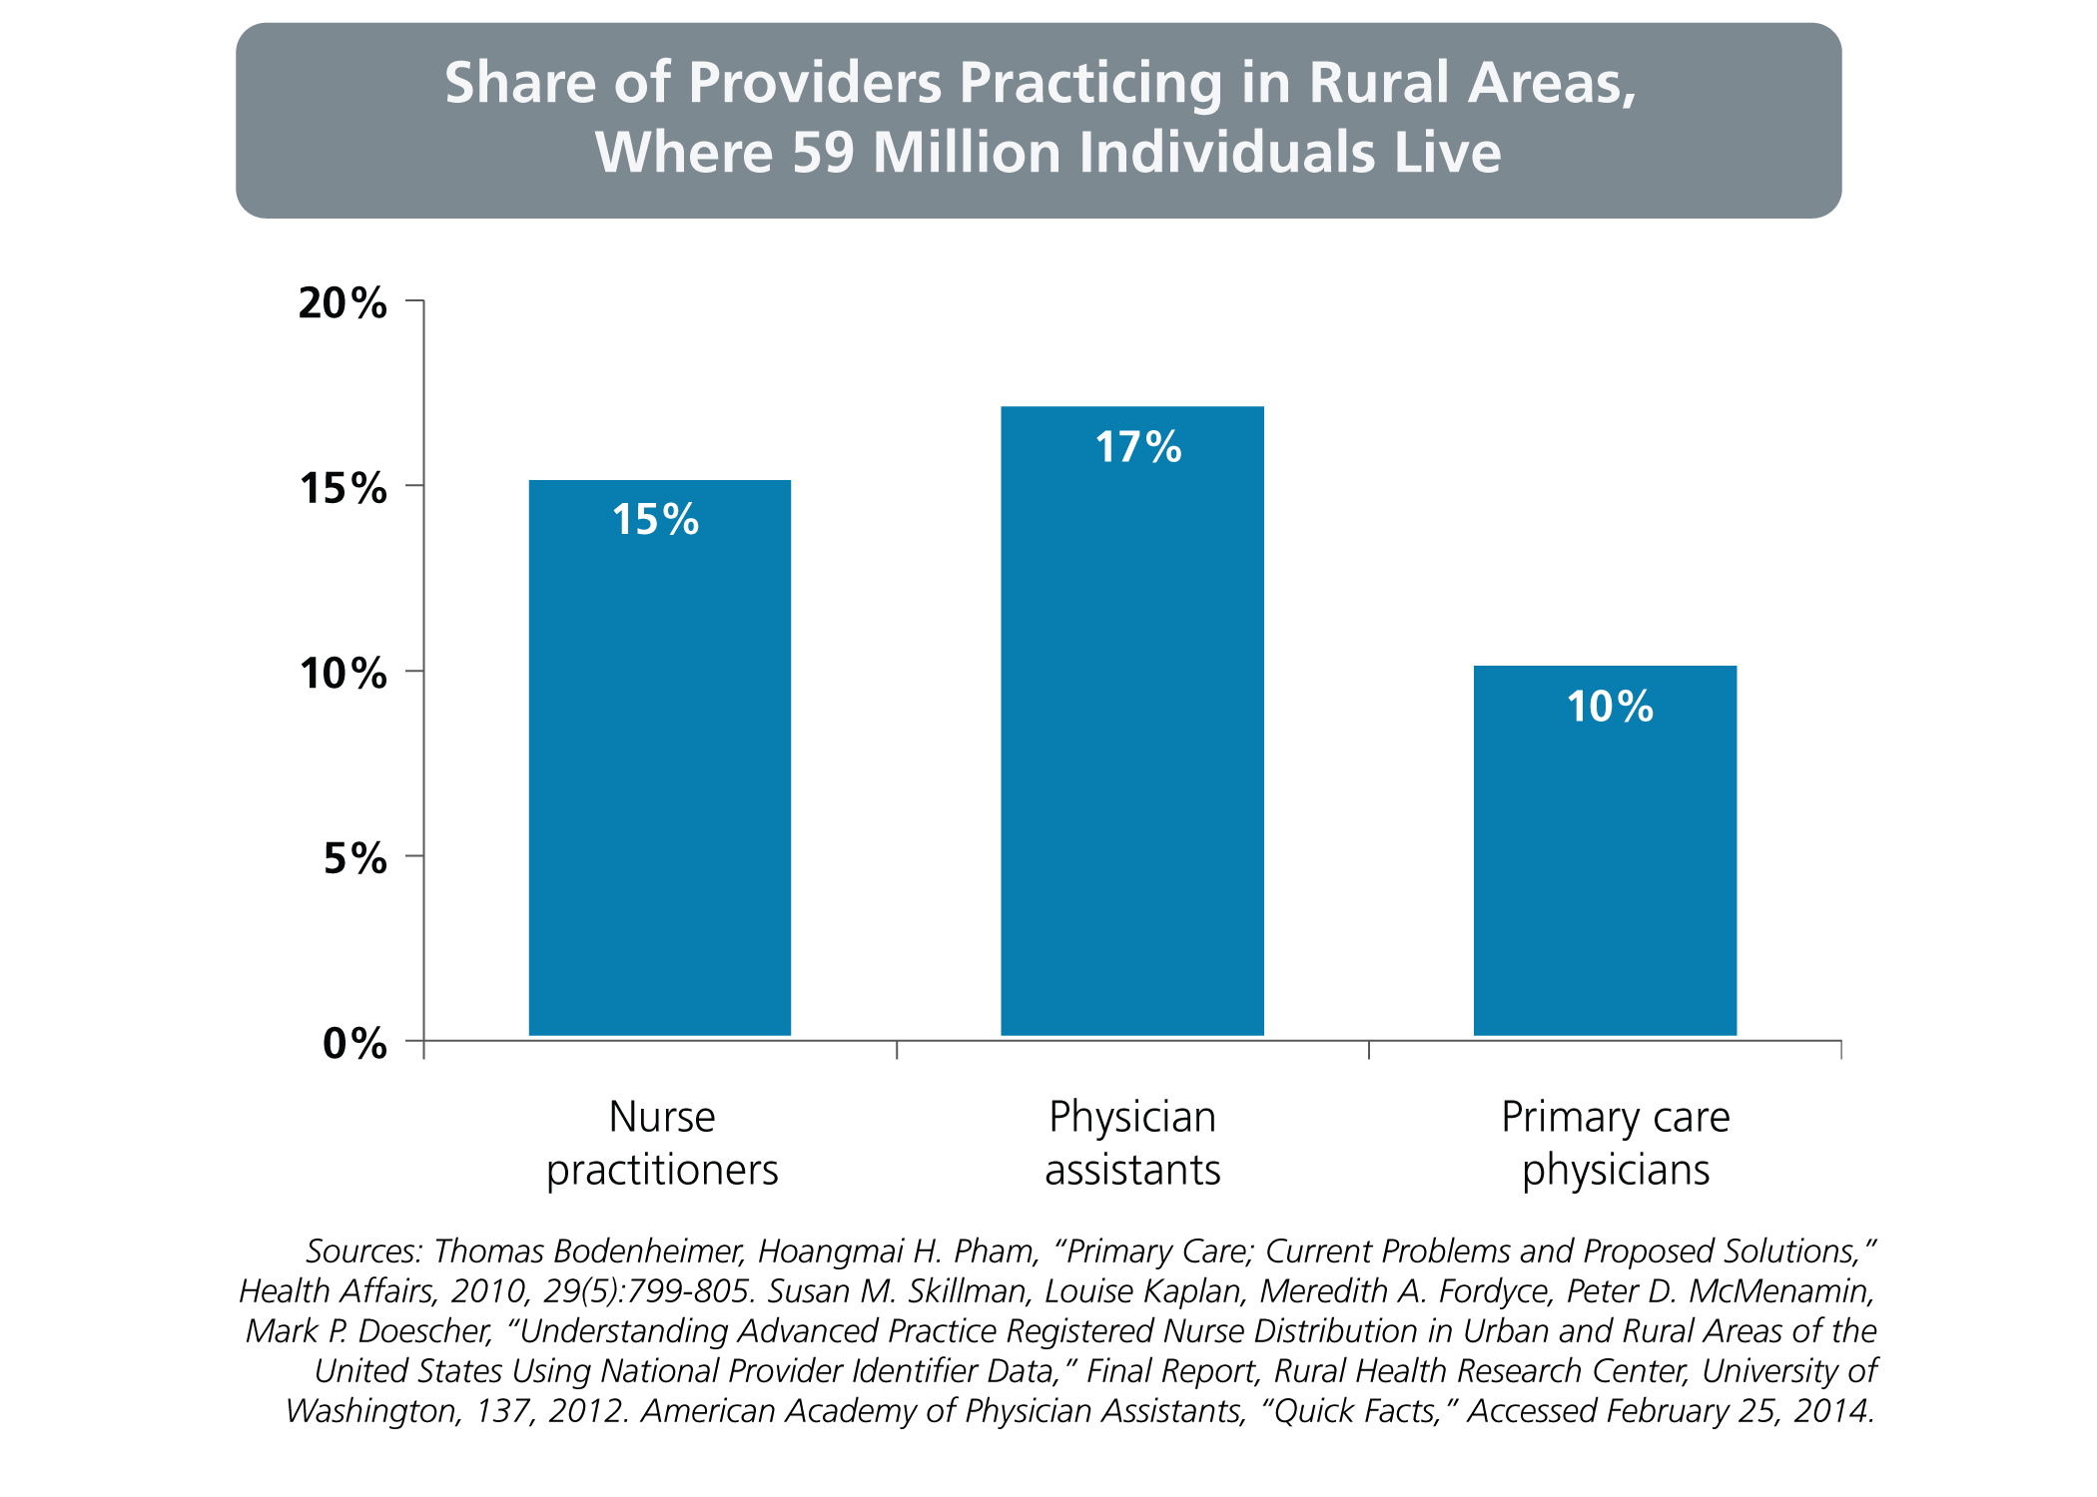
The Percentage of Nurse Practitioners and Physician Assistants Who Practice in Rural Areas is Greater Than the Percentage of Physicians

Slide 10
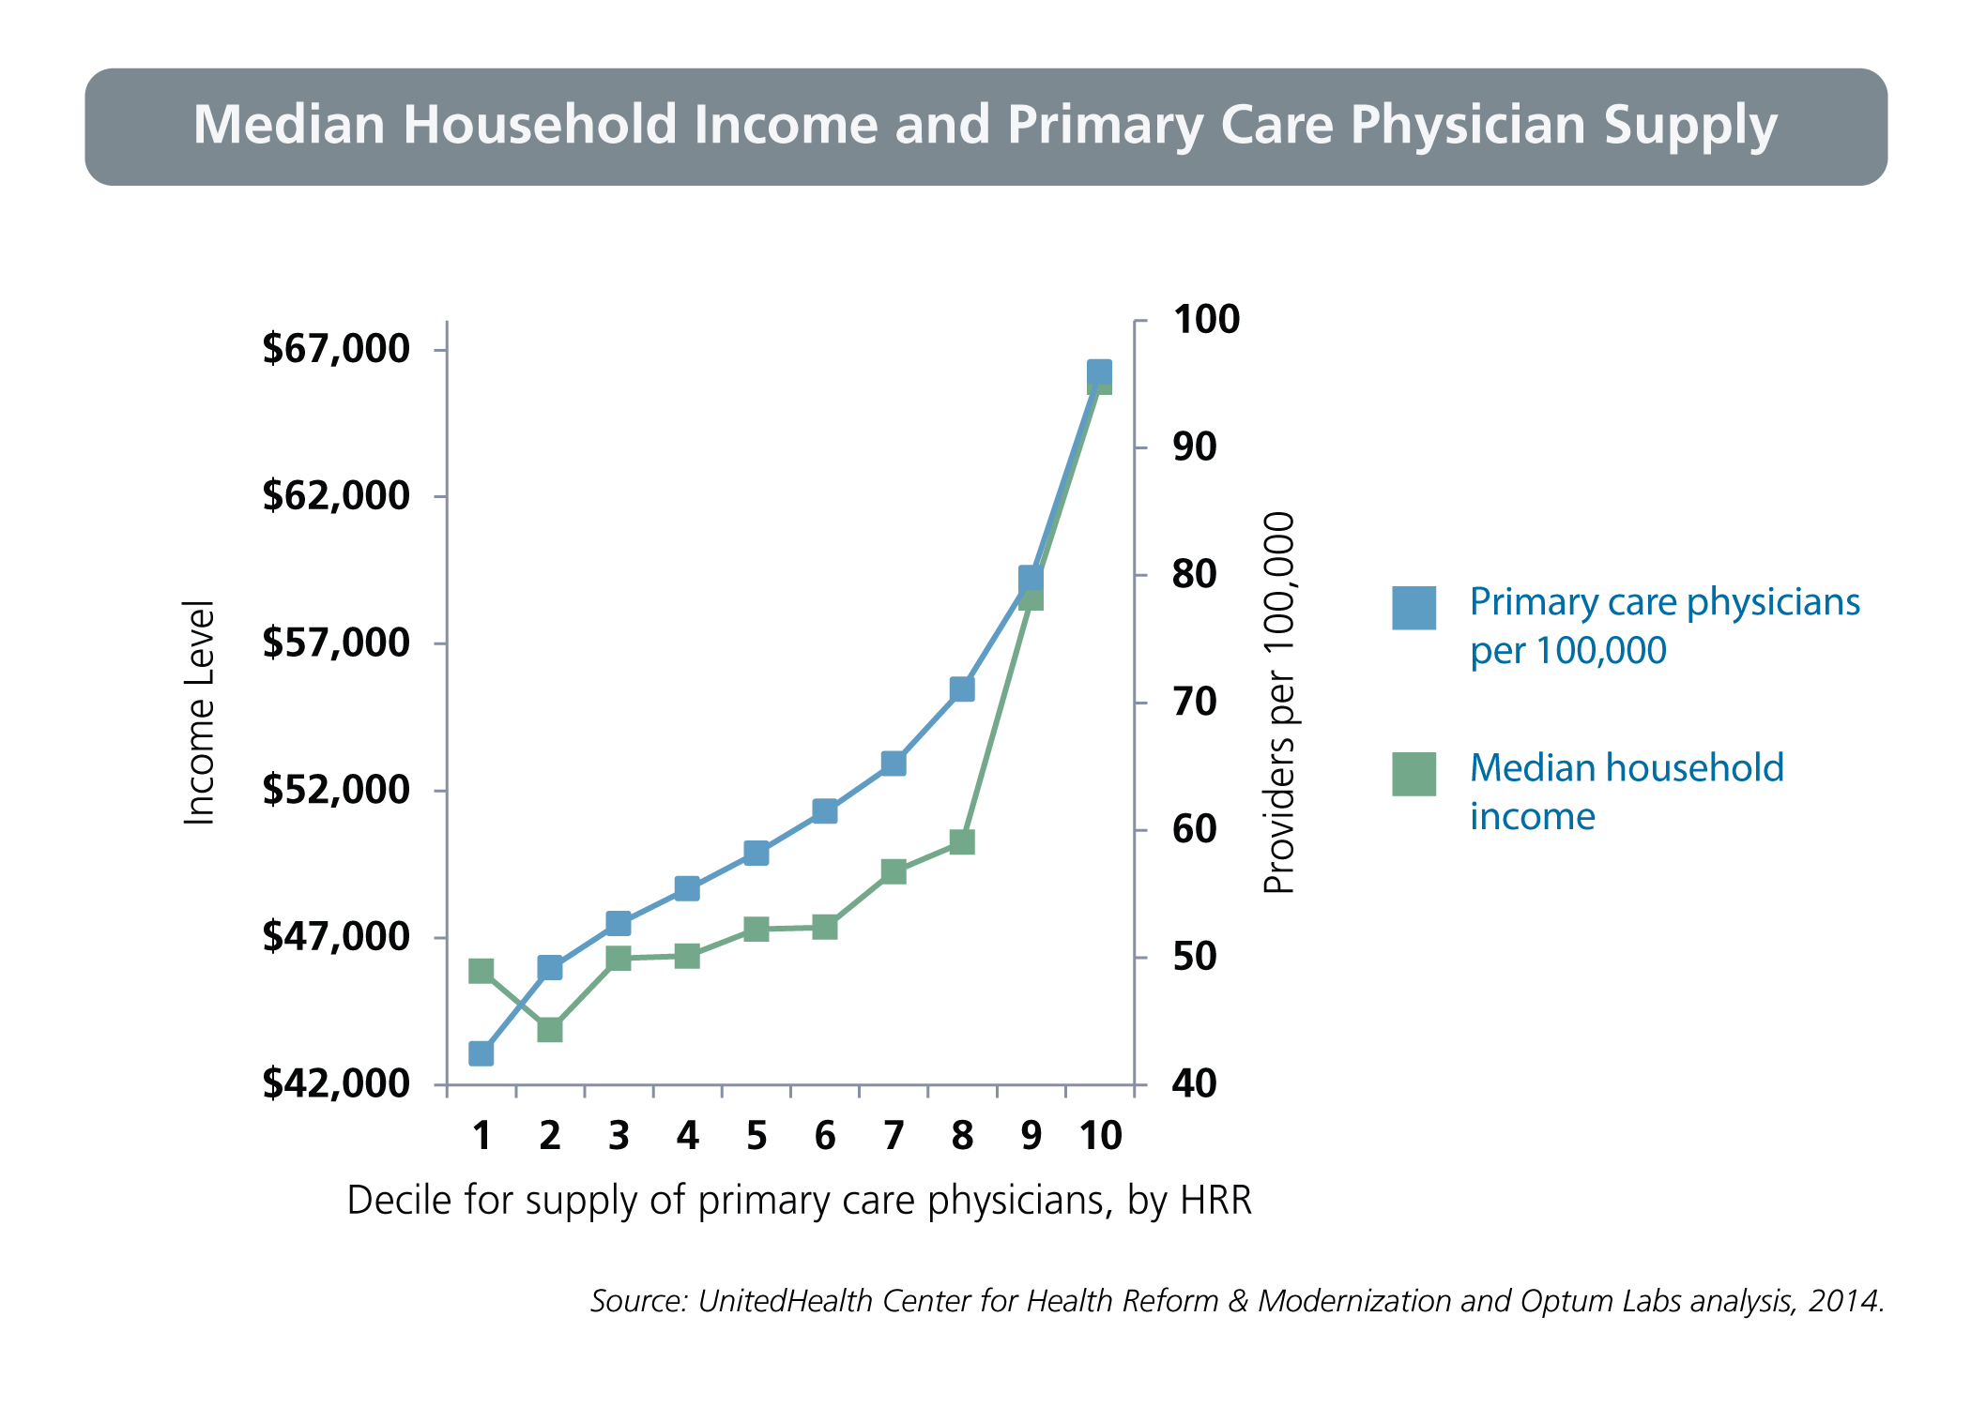
Primary Care Physicians are More Concentrated in Higher-Income Areas

Slide 11
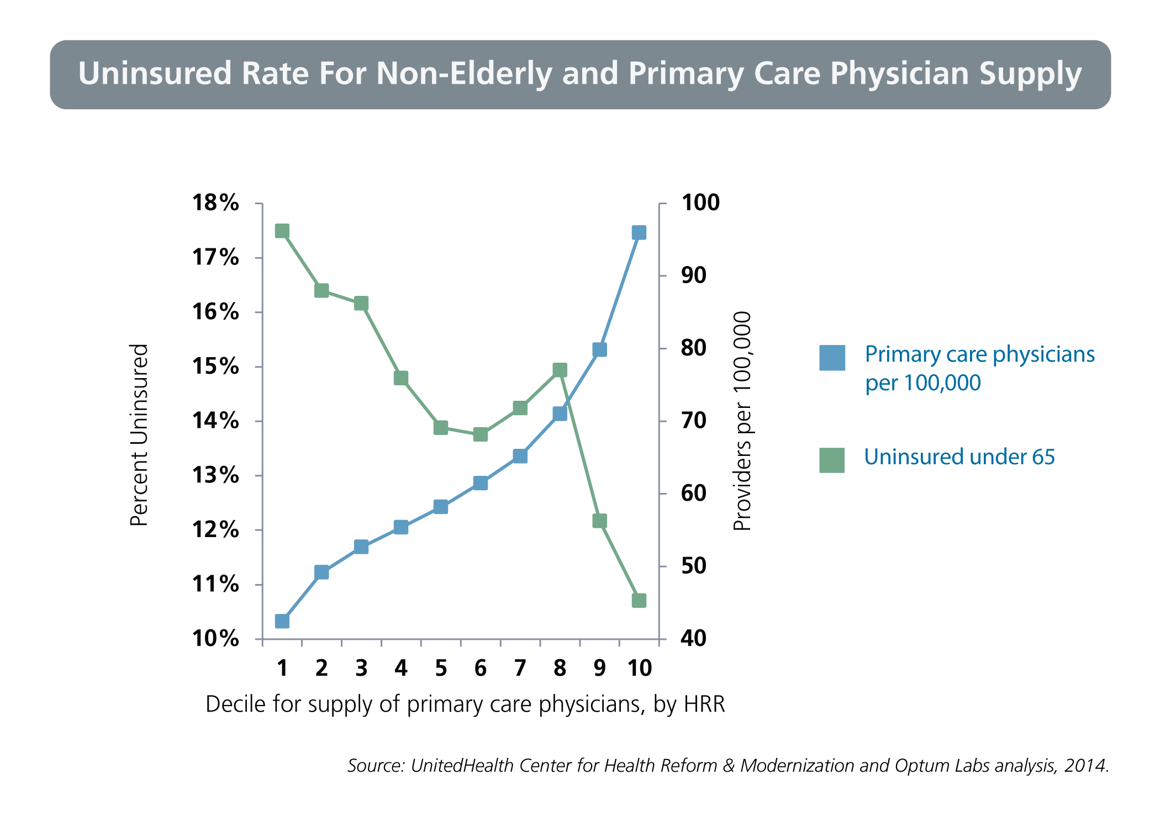
Primary Care Physicians are More Concentrated in Areas with Lower Rates of Uninsured

Slide 12
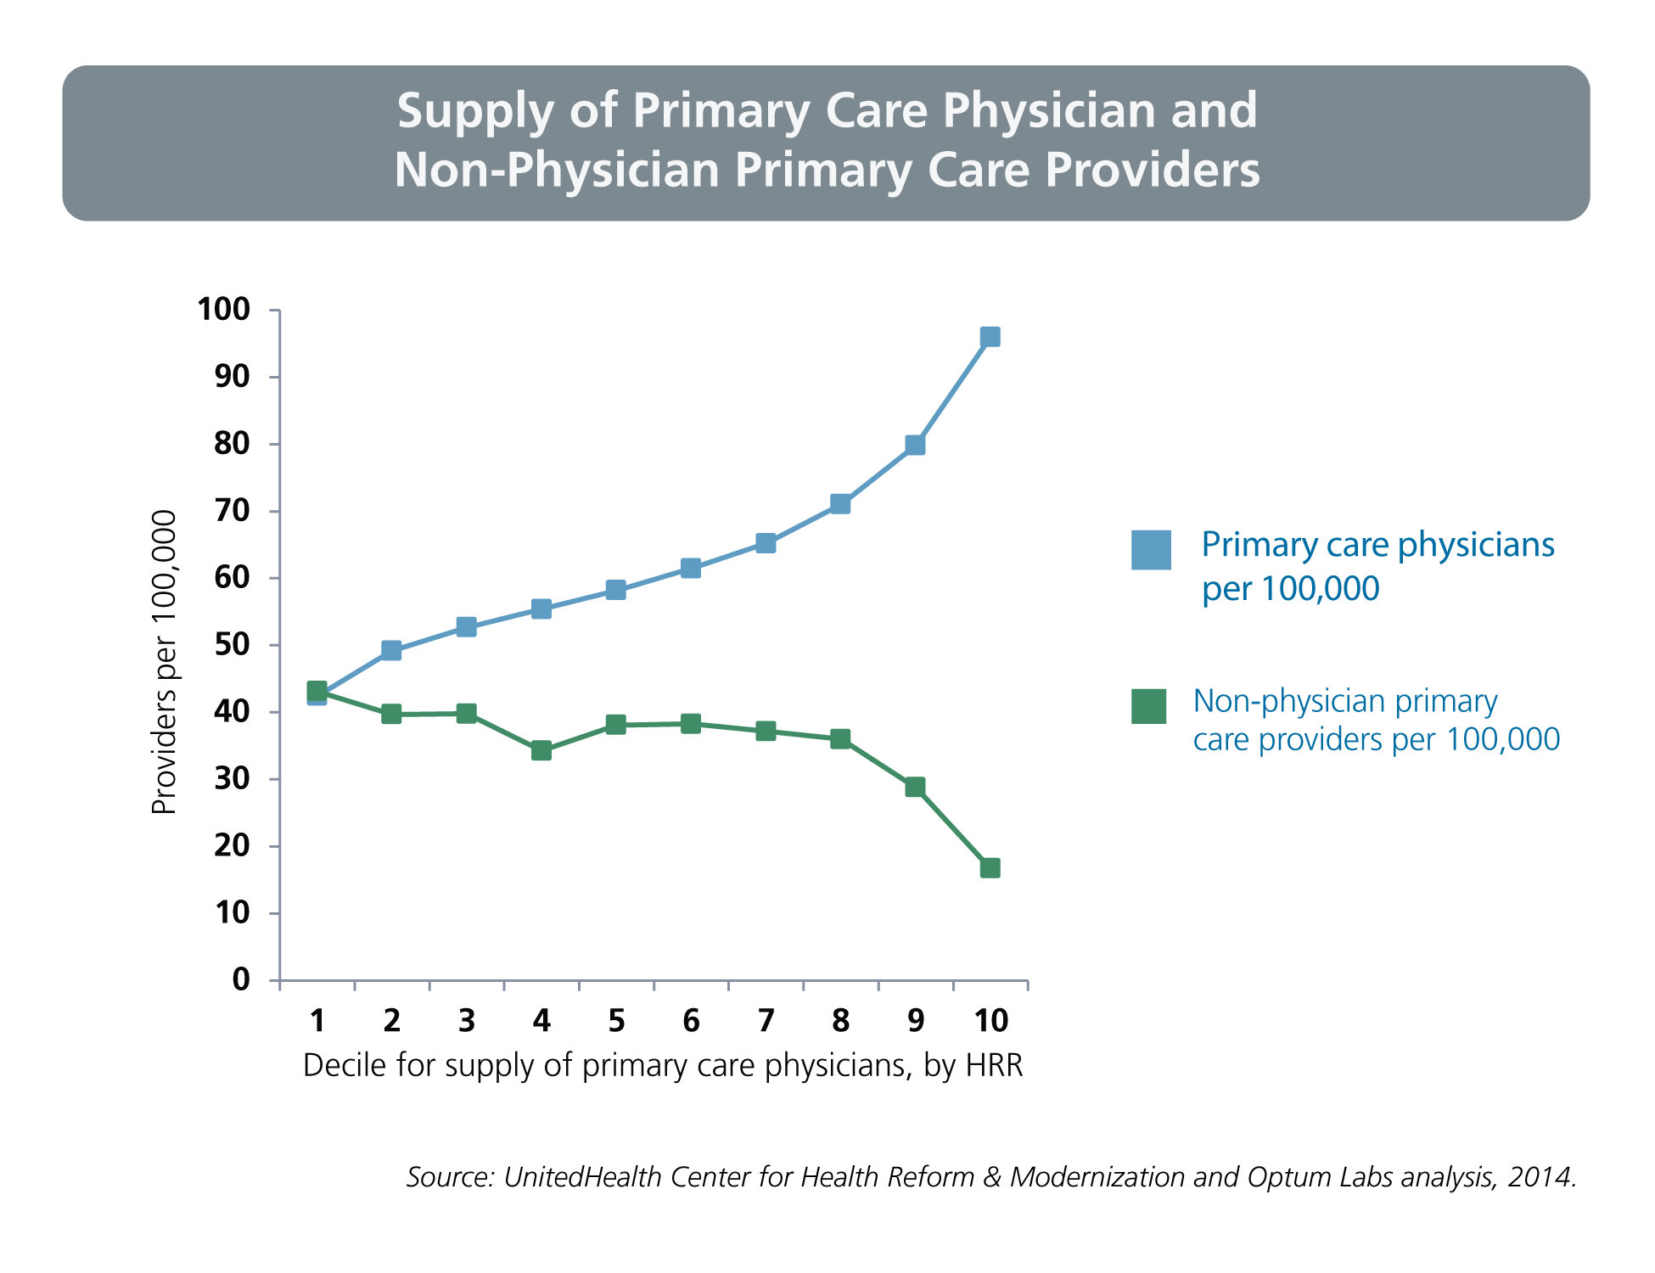
Areas with Lower Concentrations of Primary Care Physicians Have Higher Concentrations of Non-Physician Primary Care Providers

Slide 13
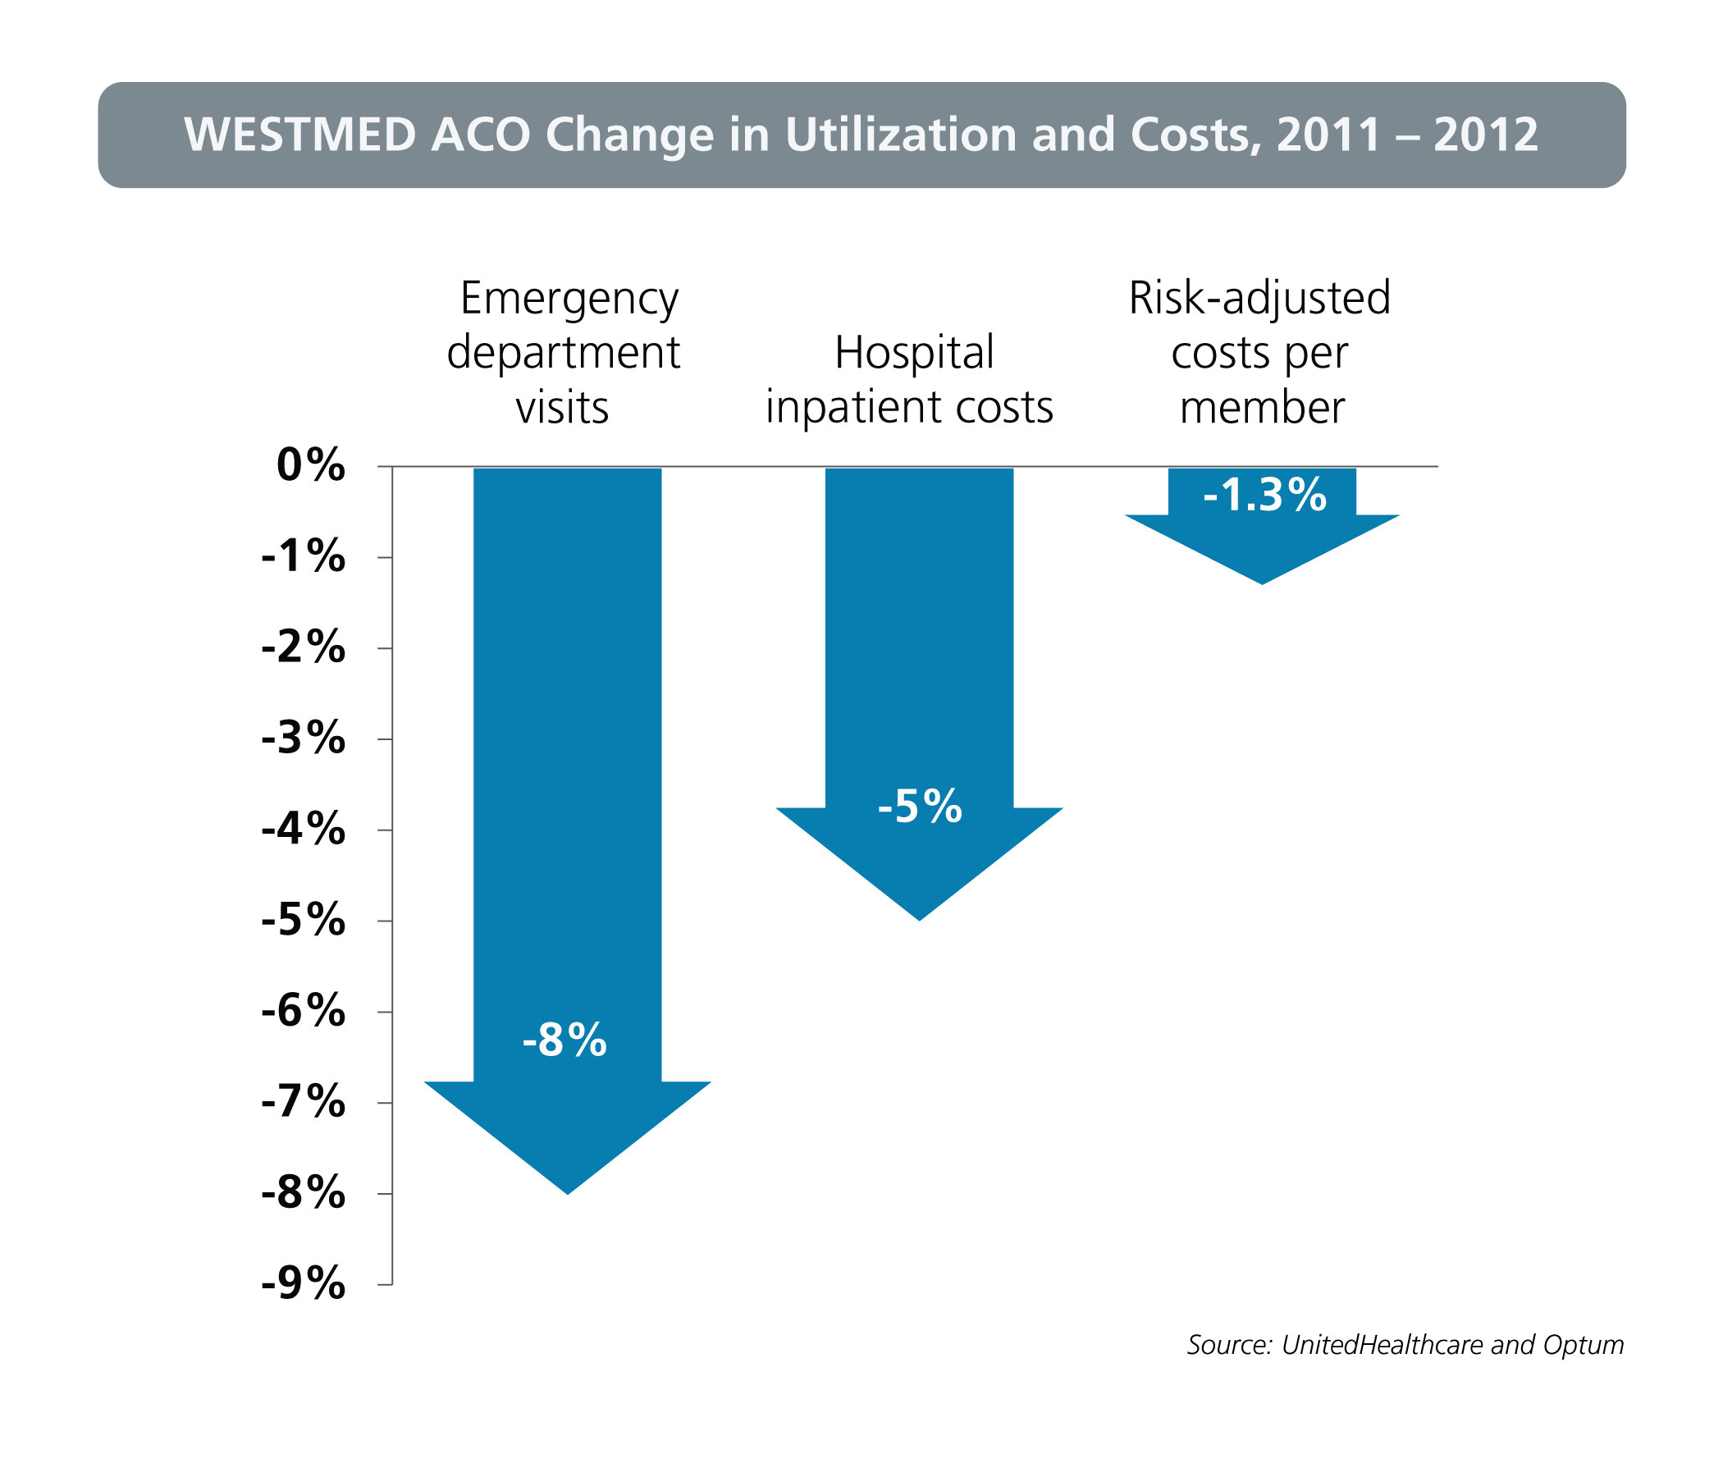
WESTMED’s Commercial ACO, in Partnership with UnitedHealthcare and Optum, Achieved Reductions in Hospital Utilization and Costs

Slide 14
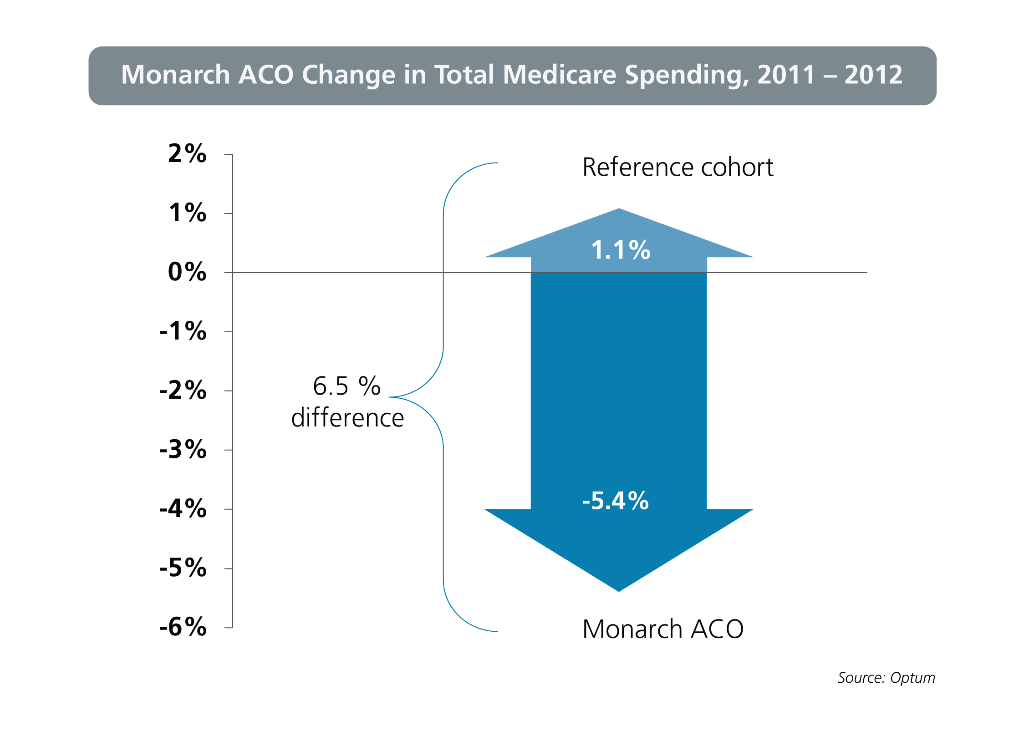
Monarch’s Medicare Pioneer ACO, in Partnership with Optum, Achieved Cost Reductions for its Patients while Spending Increased for the Reference Cohort

Slide 15
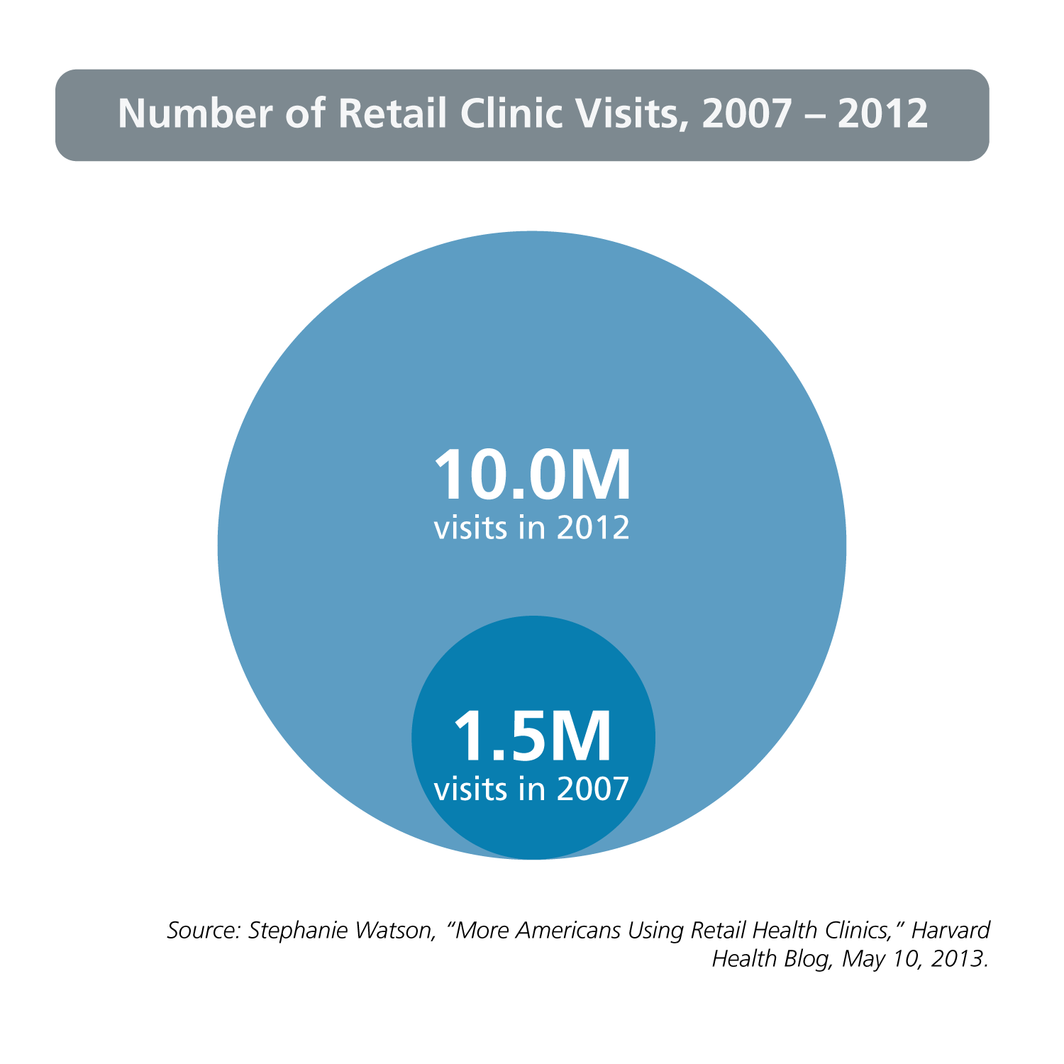
The Number of Health Care Retail Clinic Visits has Increased Dramatically in Recent Years

Slide 16
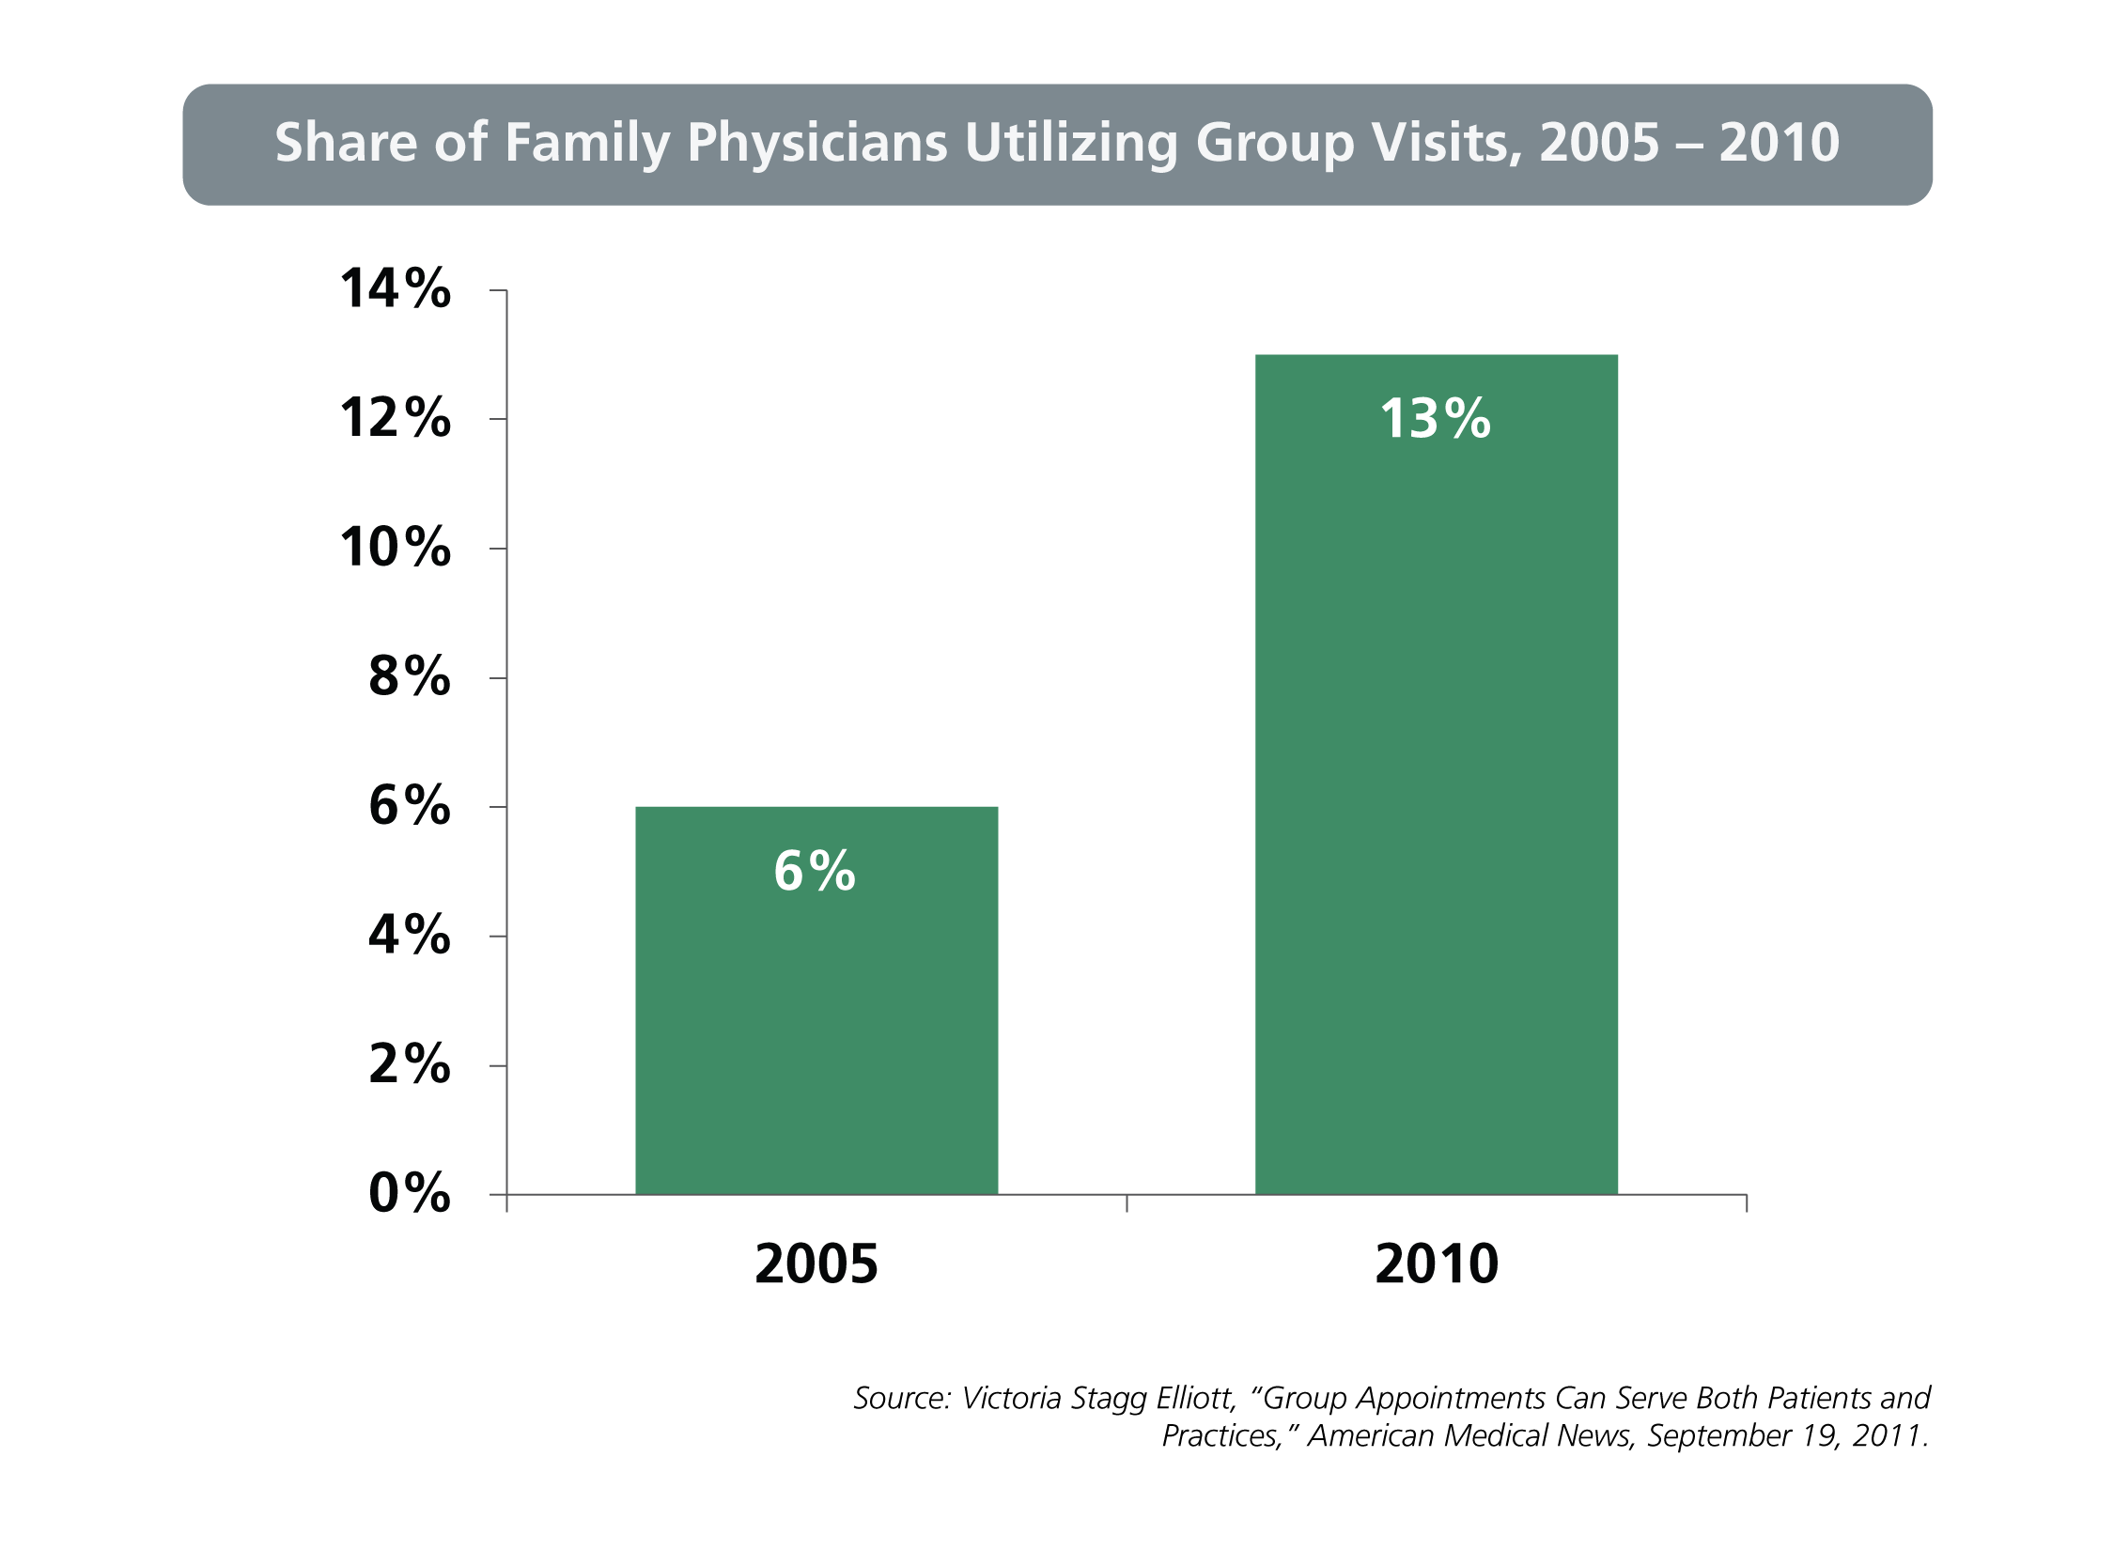
Use of Group Visits by Family Physicians Doubled Between 2005 and 2010

Slide 17
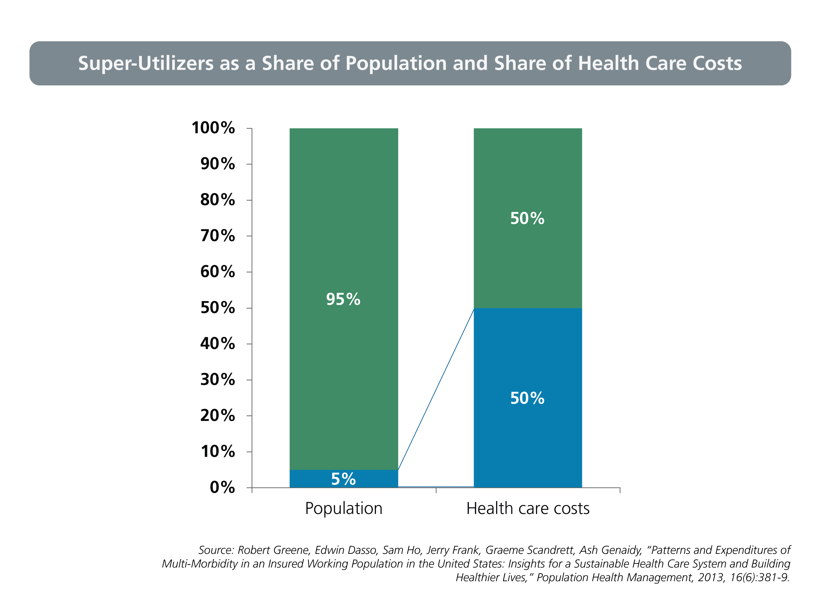
Each Year, “Super-Utilizers” – the Top 5% of the Population in Terms of Per Capita Spending – Account for 50% of All Health Care Costs

Slide 18
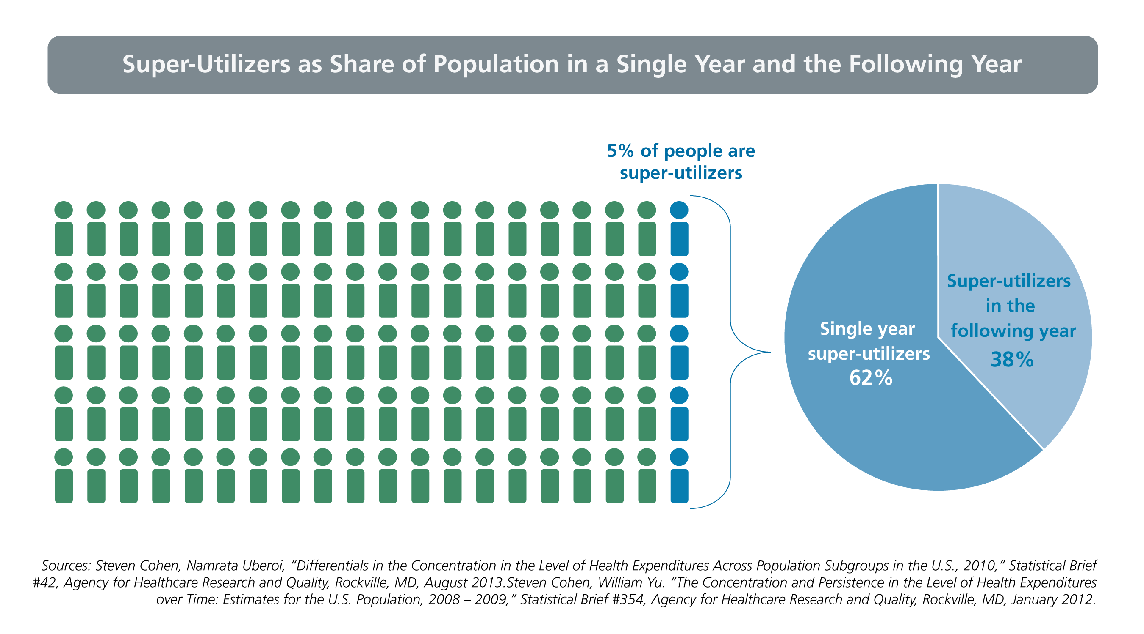
Among “Super-Utilizers,” 38% Will Remain Super-Utilizers the Following Year

